Slide 1
Decision Tree - II
Dr K.Lavanya
Associate Professor
SCOPE,VIT,Vellore
Dr S.Ramani
Assistant Professor Sr
SCOPE,VIT,Vellore

Slide 2
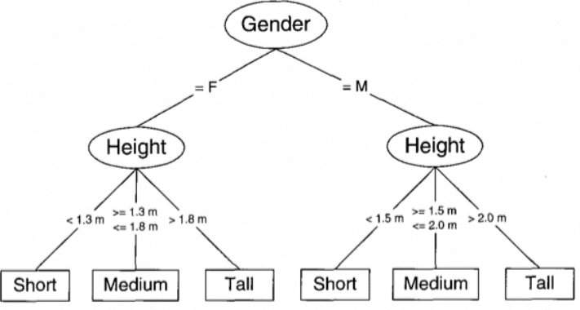
Decision Tree

Slide 3
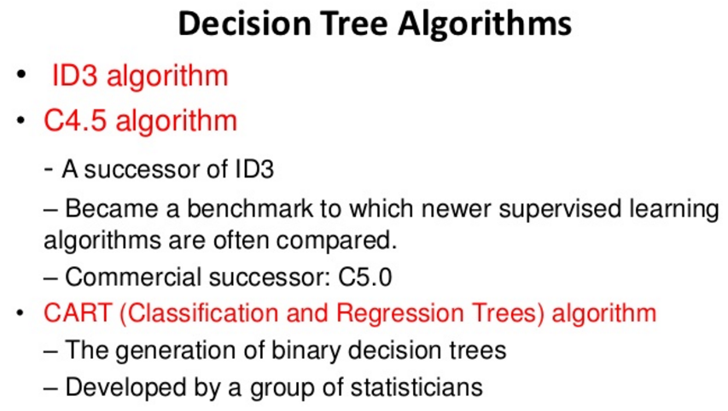

Slide 4
CART – Classification and Regression Tree
Regression and classification are categorized under the same umbrella of supervised machine learning.
An alternative decision tree building algorithm.
Handle both classification and regression.
Measure used – Gini Index

Slide 5
Classification Problem
Categorical / discrete Attributes.
Example: given the values predict play is possible or not.

Slide 6
Regression Problem
Numerical or Continuous Attributes.
Prediction – Predicting the values
Example: given the values predict the salary of a person.

Slide 7
Understanding Decision Tree using CART with an Example

Slide 8
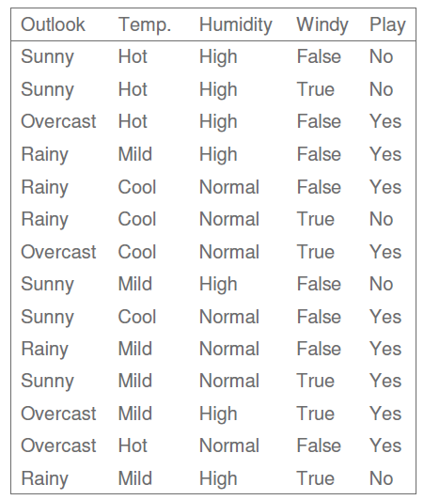

Slide 9
How to split a tree?

Slide 10
Gini Index
Gini = 1 – Σ (Pi)² i=1 to n (number of classes)
metric for classification tasks.
sum of squared probabilities of each class.

Slide 11
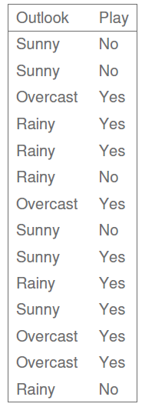
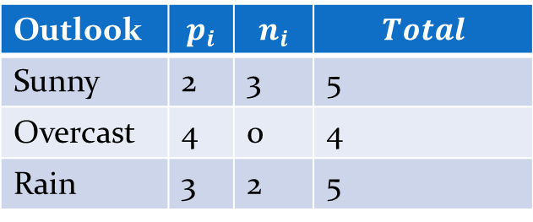
Outlook
P:yes =9 n:no =5
Outlook | $$p_{i}$$ | $$n_{i}$$ | $$Total$$
Sunny | 2 | 3 | 5
Overcast | 4 | 0 | 4
Rain | 3 | 2 | 5
Gini(Sunny) = 1 – (2/5)² – (3/5)² = 1 – 0.16 – 0.36 = 0.48
Gini(Overcast) = 1 – (4/4)² – (0/4)² = 0
Gini(Rainy) = 1 – (3/5)² – (2/5)² = 1 – 0.36 – 0.16 = 0.48

Slide 12
Weighted Sum (Outlook)
calculate weighted sum of Gini indexes for outlook.
Gini(Outlook) = (5/14) x 0.48 + (4/14) x 0 + (5/14) x 0.48
= 0.171 + 0 + 0.171
= 0.342

Slide 13
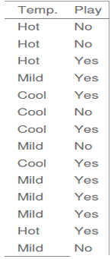
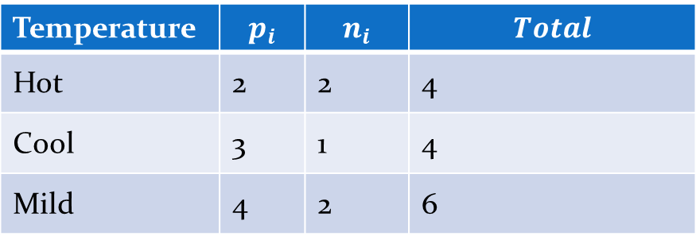
Temperature
P:yes =9 n:no =5
Temperature | $$p_{i}$$ | $$n_{i}$$ | $$Total$$
Hot | 2 | 2 | 4
Cool | 3 | 1 | 4
Mild | 4 | 2 | 6
Gini(Hot) = 1 – (2/4)² – (2/4)² = 0.5
Gini(Cool) = 1 – (3/4)² – (1/4)² = 1 – 0.5625 – 0.0625 = 0.375
Gini(Mild) = 1 – (4/6)² – (2/6)² = 1 – 0.444 – 0.111 = 0.445

Slide 14
Weighted Sum (Temperature)
calculate weighted sum of Gini indexes for Temp.
Gini(Temp.) = (4/14) x 0.5 + (4/14) x 0.375 +
(6/14) x 0.445
= 0.142 + 0.107 + 0.190
= 0.439

Slide 15
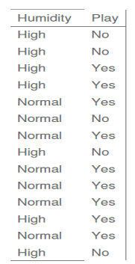
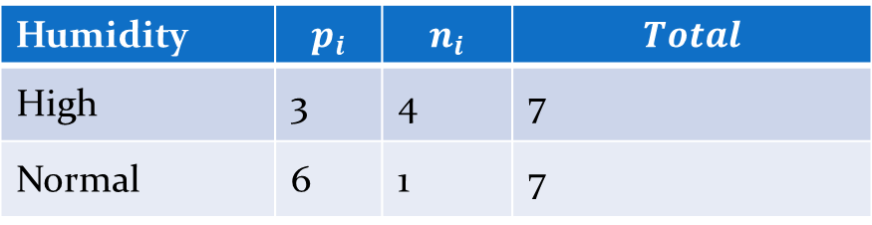
Humidity
P:yes =9 n:no =5
Humidity | $$p_{i}$$ | $$n_{i}$$ | $$Total$$
High | 3 | 4 | 7
Normal | 6 | 1 | 7
Gini(High) = 1 – (3/7)² – (4/7)² = 1 – 0.183 – 0.326 = 0.489
Gini(Normal) = 1 – (6/7)² – (1/7)² = 1 – 0.734 – 0.02 = 0.244

Slide 16
Weighted Sum (Humidity)
calculate weighted sum of Gini indexes for humidity.
Gini(Humidity) = (7/14) x 0.489 + (7/14) x 0.244 = 0.367

Slide 17
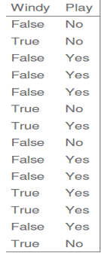
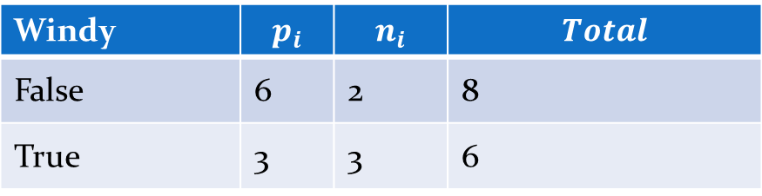
Windy
P:yes =9 n:no =5
Windy | $$p_{i}$$ | $$n_{i}$$ | $$Total$$
False | 6 | 2 | 8
True | 3 | 3 | 6
Gini(False) = 1 – (6/8)² – (2/8)² = 1 – 0.5625 – 0.062 = 0.375
Gini(True) = 1 – (3/6)² – (3/6)² = 1 – 0.25 – 0.25 = 0.5

Slide 18
Weighted Sum (Windy)
calculate weighted sum of Gini indexes for windy.
Gini(Windy) = (8/14) x 0.375 + (6/14) x 0.5 = 0.428

Slide 19
Feature | Gini index
Outlook | 0.342
Temperature | 0.439
Humidity | 0.367
Wind | 0.428
Outlook
Sunny
overcast
Rain
outlook feature because its cost is the lowest

Slide 20
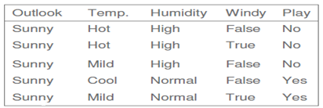
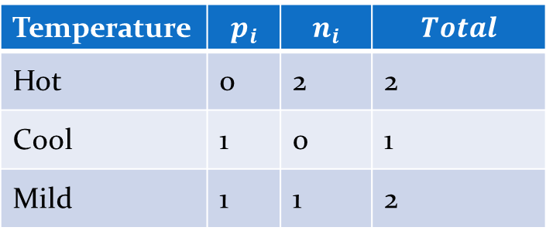
Sunny, Temperature
P:yes =2 n:no =3
Temperature | $$p_{i}$$ | $$n_{i}$$ | $$Total$$
Hot | 0 | 2 | 2
Cool | 1 | 0 | 1
Mild | 1 | 1 | 2
Gini(Sunny and Hot) = 1 – (0/2)² – (2/2)² = 0
Gini(Sunny and Cool) = 1 – (1/1)² – (0/1)² = 0
Gini(Sunny and Mild) = 1 – (1/2)² – (1/2)² = 1 – 0.25 – 0.25 = 0.5
Gini(Sunny and Temp.) = (2/5)x0 + (1/5)x0 + (2/5)x0.5 = 0.2

Slide 21
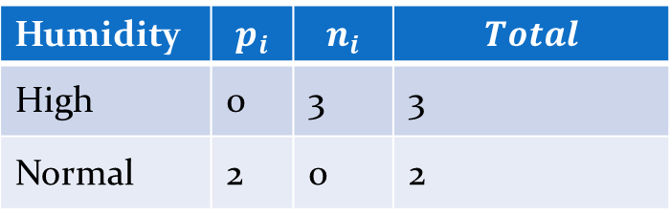
Sunny, Humidity
P:yes =2 n:no =3
Humidity | $$p_{i}$$ | $$n_{i}$$ | $$Total$$
High | 0 | 3 | 3
Normal | 2 | 0 | 2
Gini(Sunny and High) = 1 – (0/3)² – (3/3)² = 0
Gini(Sunny and Normal) = 1 – (2/2)² – (0/2)² = 0
Gini(Sunny and Humidity) = (3/5)x0 + (2/5)x0 = 0

Slide 22
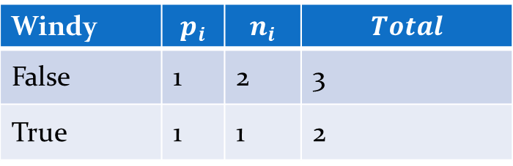
Sunny, Windy
P:yes =2 n:no =3
Windy | $$p_{i}$$ | $$n_{i}$$ | $$Total$$
False | 1 | 2 | 3
True | 1 | 1 | 2
Gini(Sunny and False) = 1 – (1/3)² – (2/3)² = 0.266
Gini(Sunny and True) = 1- (1/2)² – (1/2)² = 0.2
Gini(Sunny and Windy) = (3/5)x0.266 + (2/5)x0.2 = 0.466

Slide 23
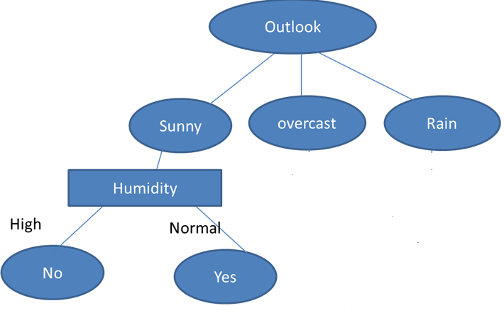
Feature | Gini index
Temperature | 0.2
Humidity | 0
Wind | 0.466
humidity because it has the lowest value.

Slide 24
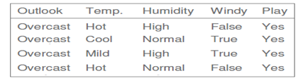
Outlook
Sunny
overcast
Rain
Humidity
Yes
High
Normal
No
Yes

Slide 25
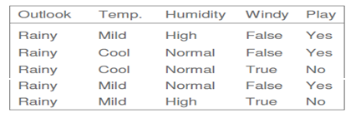
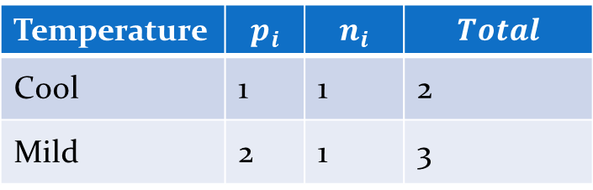
Rainy, Temperature
P:yes =3 n:no =2
Temperature | $$p_{i}$$ | $$n_{i}$$ | $$Total$$
Cool | 1 | 1 | 2
Mild | 2 | 1 | 3
Gini(Rainy and Cool) = 1 – (1/2)² – (1/2)² = 0.5
Gini(Rainy and Mild) = 1 – (2/3)² – (1/3)² = 0.444
Gini(Rainy and Temp.) = (2/5)x0.5 + (3/5)x0.444 = 0.466

Slide 26

Rainy, Humidity
P:yes =3 n:no =2
Humidity | $$p_{i}$$ | $$n_{i}$$ | $$Total$$
High | 1 | 1 | 2
Normal | 2 | 1 | 3
Gini(Rainy and High) = 1 – (1/2)² – (1/2)² = 0.5
Gini(Rainy and Normal) = 1 – (2/3)² – (1/3)² = 0.444
Gini(Rainy and Humidity) = (2/5)x0.5 + (3/5)x0.444 = 0.466

Slide 27
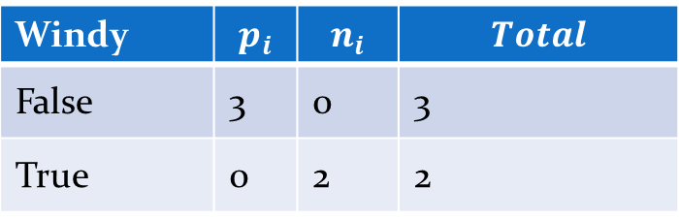
Rainy, Windy
P:yes =3 n:no =2
Windy | $$p_{i}$$ | $$n_{i}$$ | $$Total$$
False | 3 | 0 | 3
True | 0 | 2 | 2
Gini(Rainy and False) = 1 – (3/3)² – (0/3)² = 0
Gini(Rainy and True) = 1 – (0/2)² – (2/2)² = 0
Gini(Rainy and Windy) = (3/5)x0 + (2/5)x0 = 0

Slide 28
Outlook
Windy because it has the lowest value.
Sunny
overcast
Rain
Humidity
Yes
Wind
High
Normal
No
False
True
Yes
Yes
No
Feature | Gini index
Temperature | 0.466
Humidity | 0.466
Wind | 0

Slide 29
Outlook
Final Decision Tree
Sunny
overcast
Rain
Humidity
Yes
Wind
High
Normal
No
False
True
Yes
Yes
No

Slide 30
Summary
Classification and Regression Trees are easy to understand for predicting or classifying new records.
Decision tree is a graphical representation of a set of rules

